Slide 1

Restro_bot
Guided by Dr.S.Suthir Sir
Team 26

Slide 2
Team Members
 | Vivek Dharewa | 20BAI10032
 | Shivang Singh Negi | 20BAI10171
 | Ameya Shrikant | 20BAI10183
 | Tanay Kishore Singh | 20BAI10226

Slide 3



Introduction
Why Chatbot?
Trending topic from past several years
Best suited for intermediate programmers
A chatbot is an automated conversation partner. It facilitates a conversation between a human and a computer.
Types:
1. Rule-based Chatbots
2. Retrieval-based Chatbots
3. Deep-learning Chatbots

Slide 4
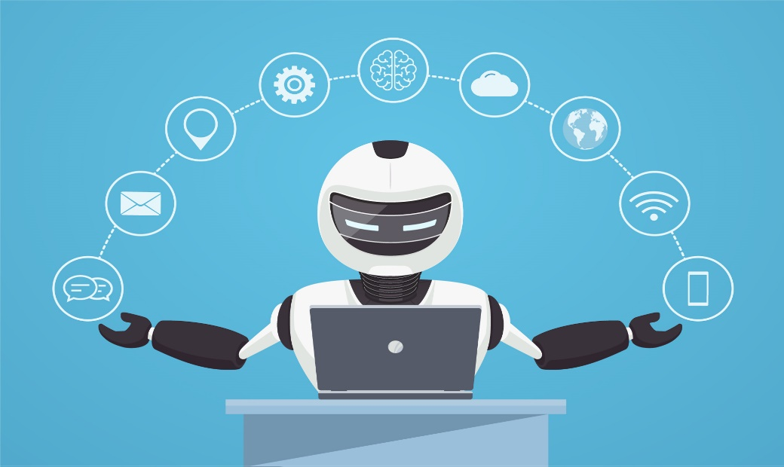
Existing Work with Limitations
Most modern chatbots use Natural language Processing (NLP) and machine learning (ML) to understand customer questions and automate responses to them, simulating human conversation.
A more notable growth is seen in AI-driven virtual assistant like Siri, Alexa, Google assistant, Cortana etc.

Slide 5
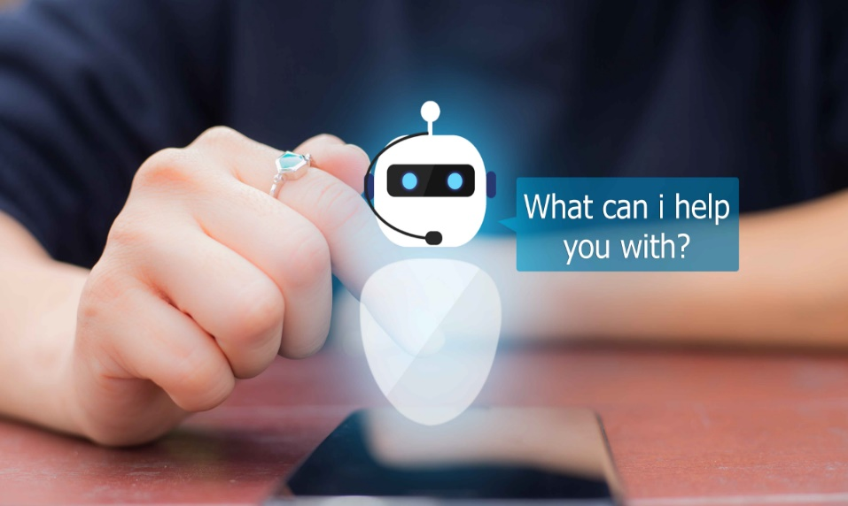
Some limitations of chatbots are:
As the database, used for output generation, is fixed and limited, chatbots can fail while dealing with an unsaved query.
A chatbot's efficiency highly depends on language processing and is limited because of irregularities, such as accents and mistakes.
Chatbots have difficulty managing non-linear conversations that must go back and forth on a topic with a user.

Slide 6
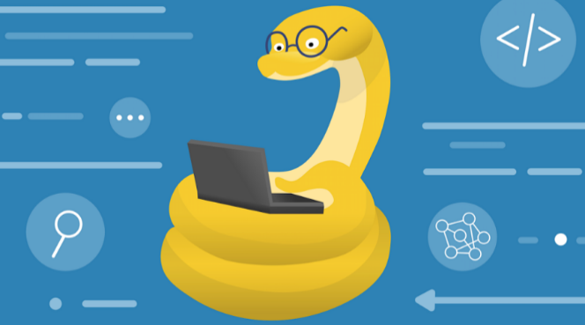
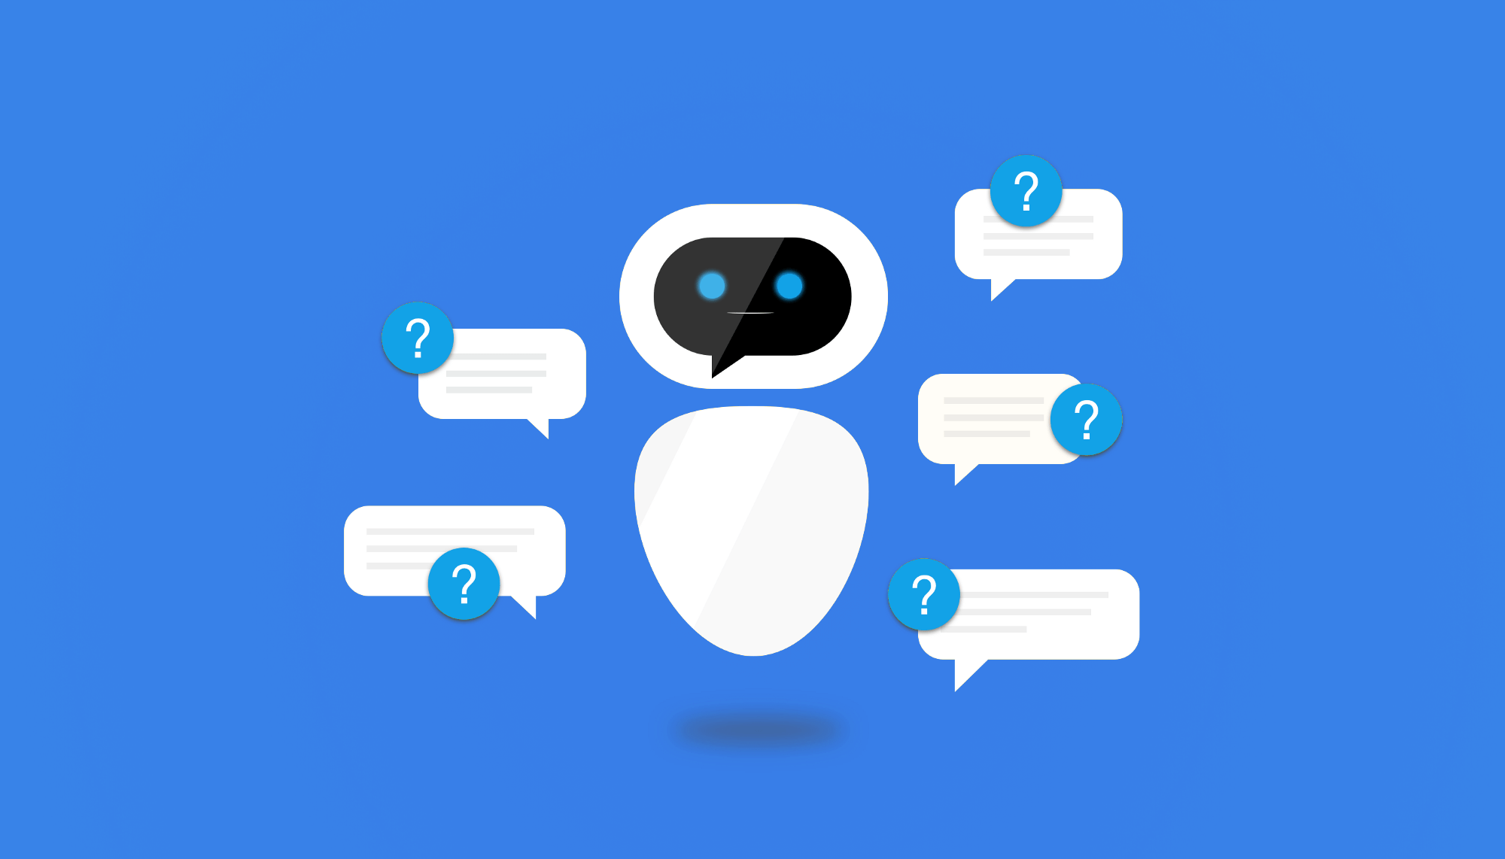
Proposed work and methodology
Understanding the concept of chatbot
Exploring features of Retrieval-based chatbot
Learning the required libraries and packages
Coding and implementation of chatbot in colab

Slide 7

Real time usage
It can be implemented on mobile applications as well as on websites
It will help users to find the exact thing in apps or websites
Currently this type of chatbot is deployed on the IRCTC website by the name of DISHA

Slide 8
Hardware & Software Requirements
Hardware Requirement:
Chatbot is a software application thus no such hardware is required.
Software Requirements:
Any desktop/mobile device with modern CPU’s and GPU’s can train the data on their device. No particular OS requirements.

Slide 9
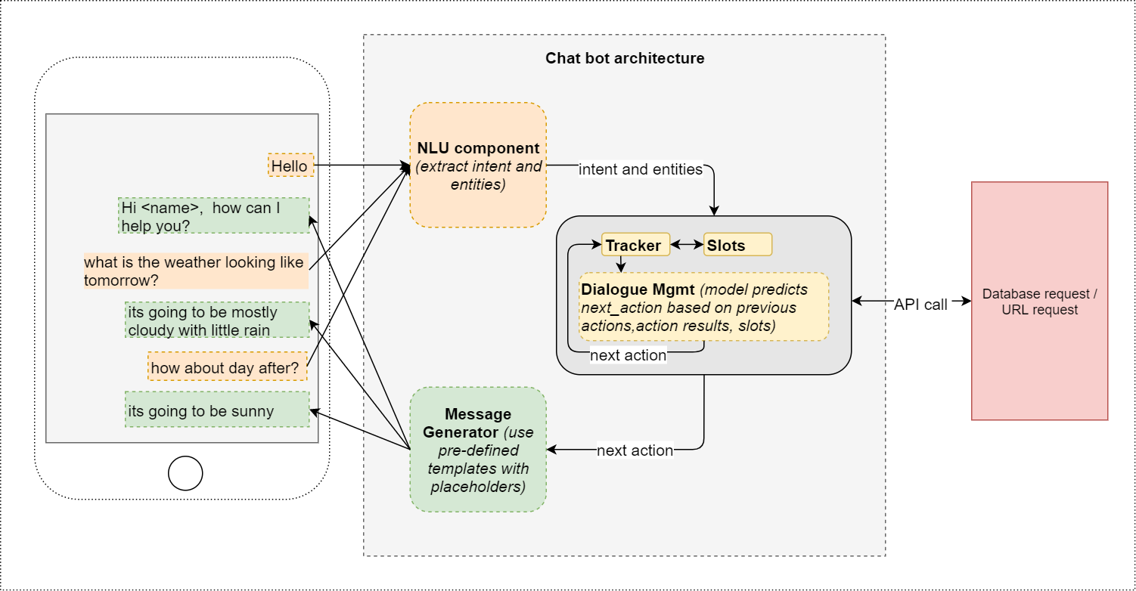
Overall system architecture diagram

Slide 10
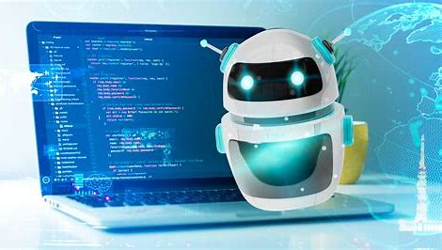
Module Description
1.
Restro’s Code
2.
Restro’s GUI
3.
Website for implementation

Slide 11
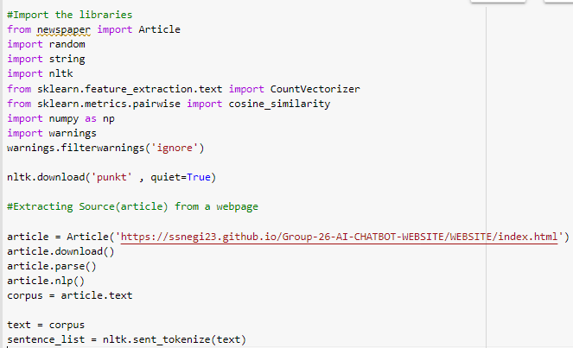
Code of Restro

Slide 12
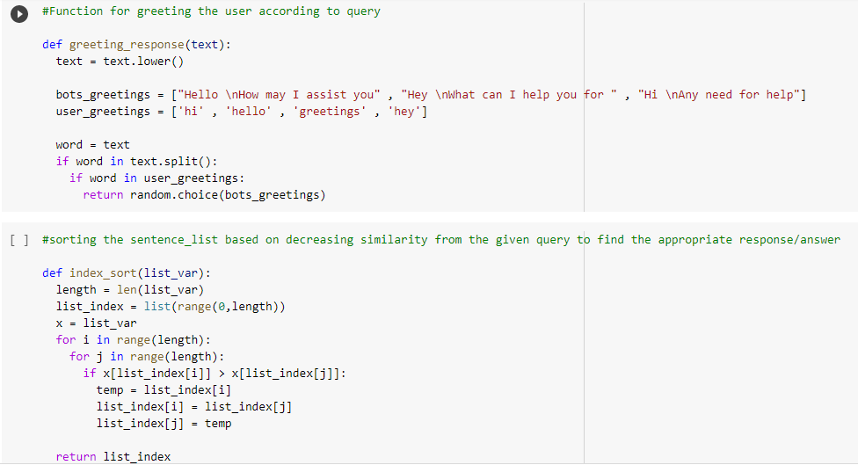

Slide 13
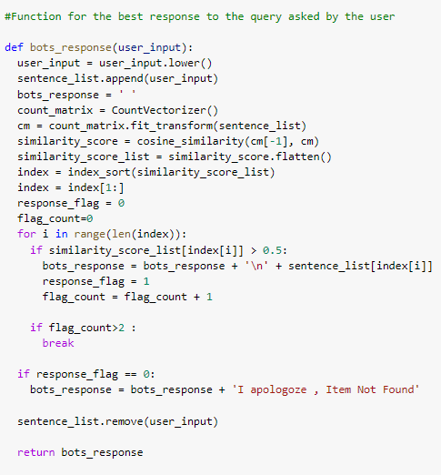
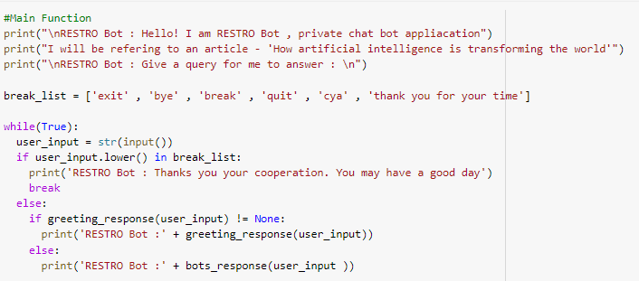
Website Code GitHub –
https://github.com/SSNegi23/Group-26-AI-CHATBOT-WEBSITE

Slide 14
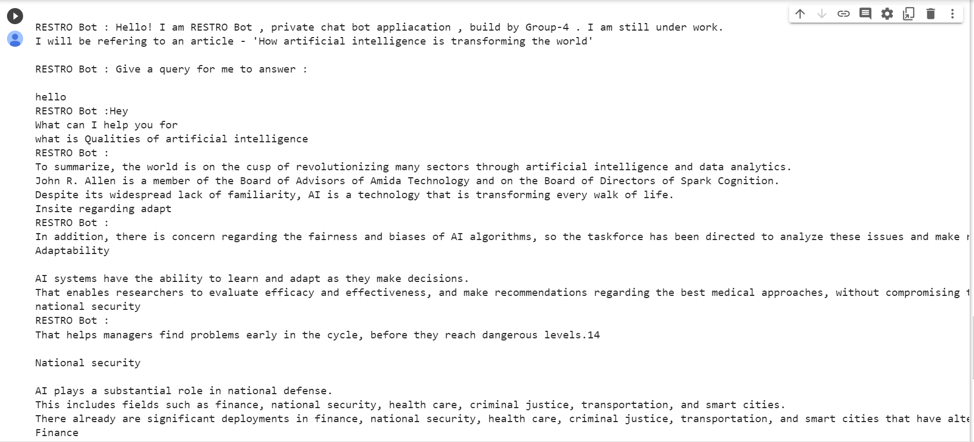
Implementation of Restro

Slide 15
Literature review
There are certain frameworks available which are commonly used for making chatbots:
Microsoft Bot Framework:
Bot Framework SDK contains services to create bots easily and it is available in C#, JS, Python, and Java.
Wit.ai:
Another product by Facebook Engineering and is also coming as an SDK for NodeJS, Python, Ruby and Go.
Rasa:
Rasa can be considered as an open source machine learning framework for automating conversations. This framework supports integrating the bot to various chat applications easily. It gives full control over the chatbot

Slide 16
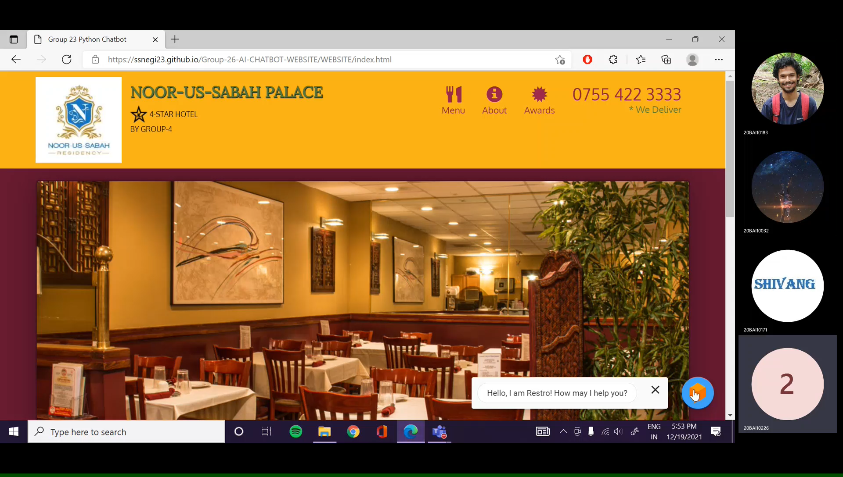
Demo Video

Slide 17
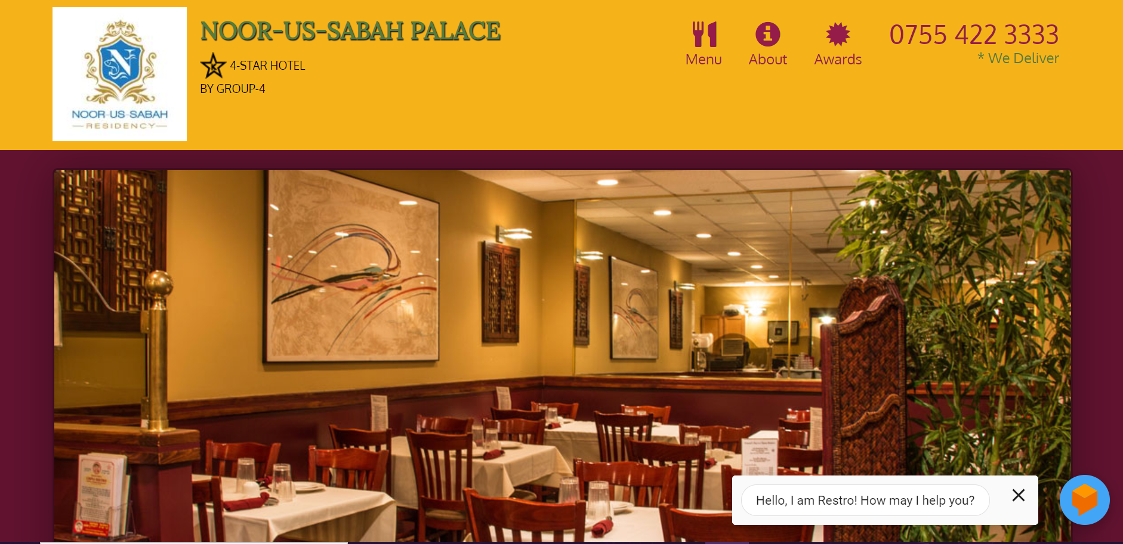
Snapshots of the project

Slide 18
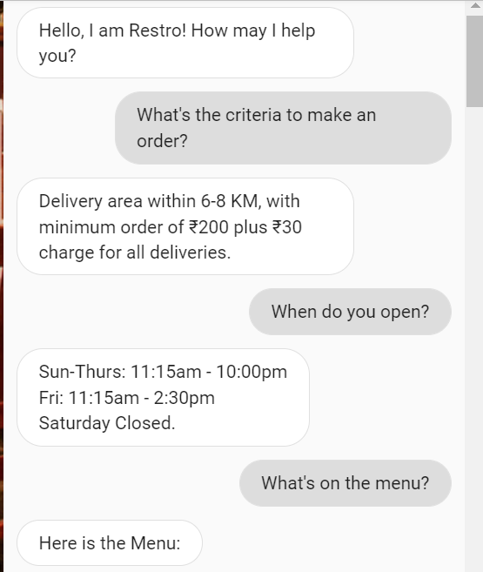
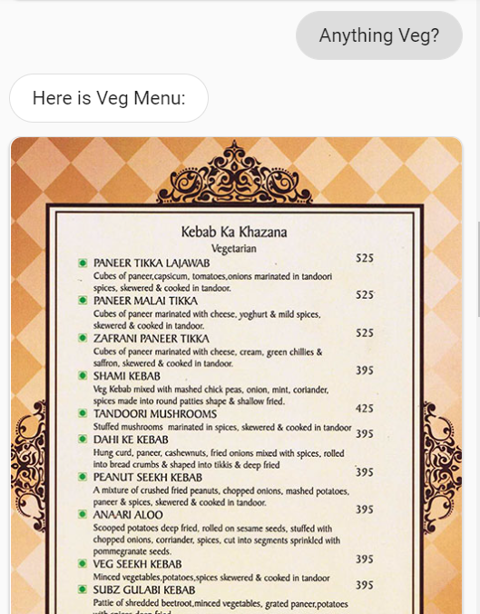
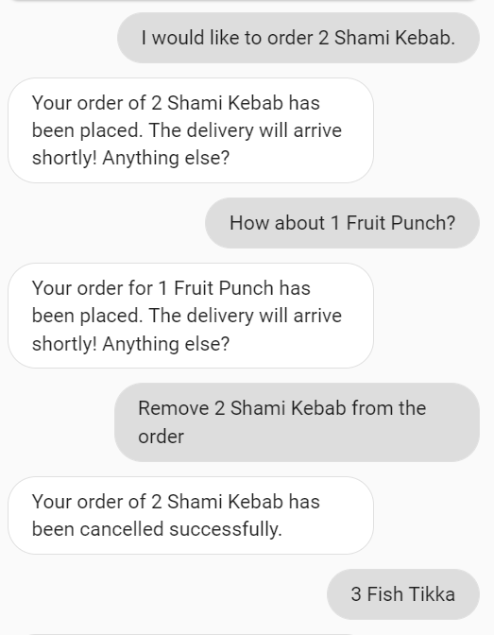
Testing

Slide 19
Results and Discussion
Upon testing as evident from the images, Restro the chatbot can understand the input from the user and generate an appropriate response. The emphasis is on human-like interaction. The interface is easy to use and navigate for the user.
Future enhancements for Restro will primarily focus on implementing various kinds of 3rd party API’s like say GPS for tracking an order and also to allow the user to mark the delivery address or some database to store past records. Such integration are quite complex and as such will be worked upon in the future.

Slide 20
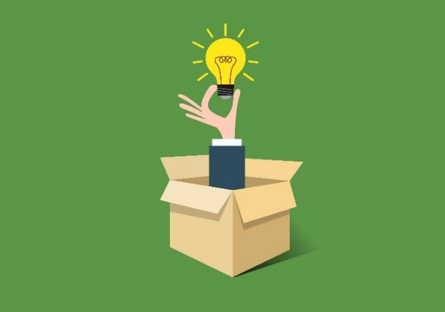
Novelty of the project
Restro is a very interactive and easy to use chatbot since it offers various options by itself in the form of coupon and also provides images of the menu. This makes it very easy for the user to understand and use the chatbot in a quick and efficient way

Slide 21
Conclusion
Working on this project not only enabled us to understand the advantages of a chatbot but also the challenges associated with designing one. Our Food ordering chatbot, Restro can perform the necessary functions which we wanted it to implement. It ability to have human-like conversation and being able to repond correctly to requests make it a great foundation upon which a fully functional Professional Chatbot can be made in the future.

Slide 22
Thank You

